Slide 1
BB2950 Day 19: Tuesday 11-28-17
Learning objectives:
Explain what happens during each stage of transcription in bacteria and eukaryotes.
Describe the two mechanisms of transcriptional termination in bacteria.
Describe the basic structure of eukaryotic promoters.
Explain the role of general transcription factors and the mediator complex in eukaryotic transcription.
Describe some of the differences between bacterial RNA polymerase and eukaryotic RNA polymerase II.
Describe some of the differences between eukaryotic RNA Pol I, II, and III.
Describe the general processing steps that RNA pol II transcripts undergo in order to become mRNAs, and contrast this to how mRNAs are generated in bacteria.
Describe the three major ways in which eukaryotic mRNAs are processed.

Slide 2
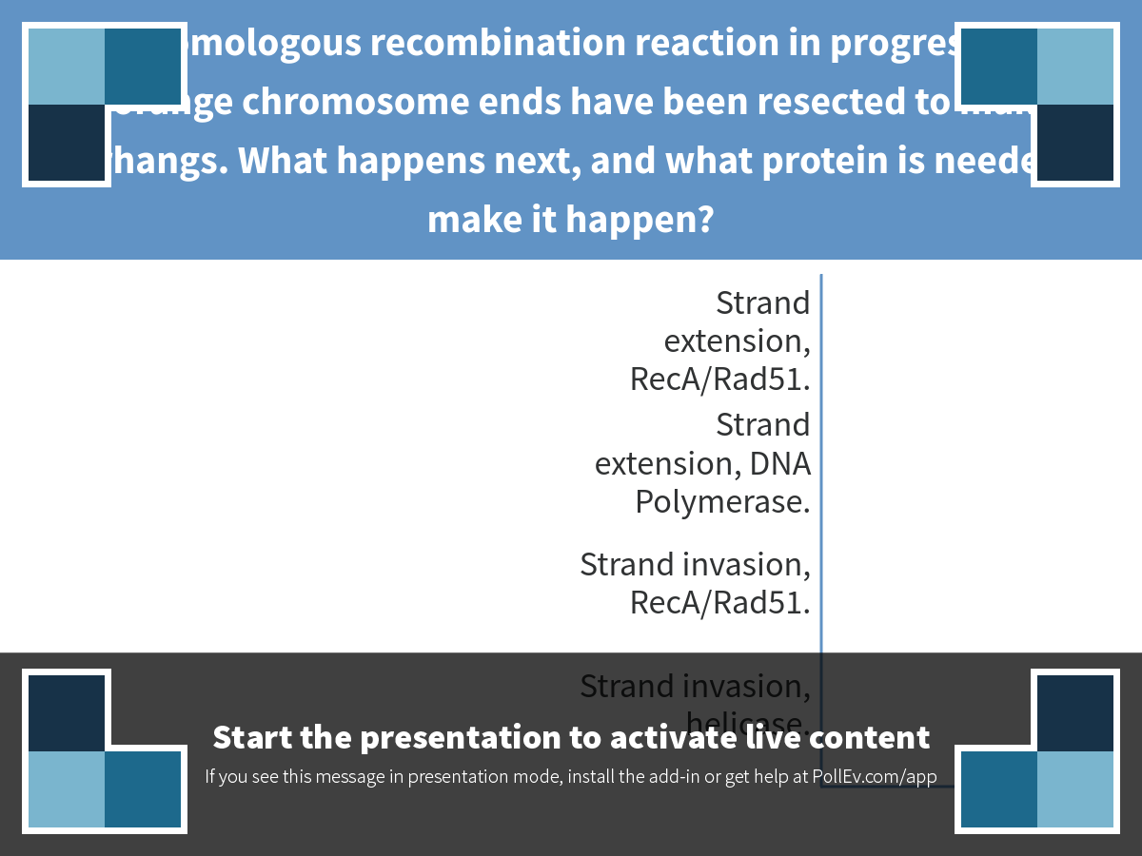
Notes:
In the homologous recombination reaction in progress below, the orange chromosome ends have been resected to make 3' overhangs. What happens next, and what protein is needed to make it happen?
https://www.polleverywhere.com/multiple_choice_polls/qmd4KSilPx2PHjg

Slide 3
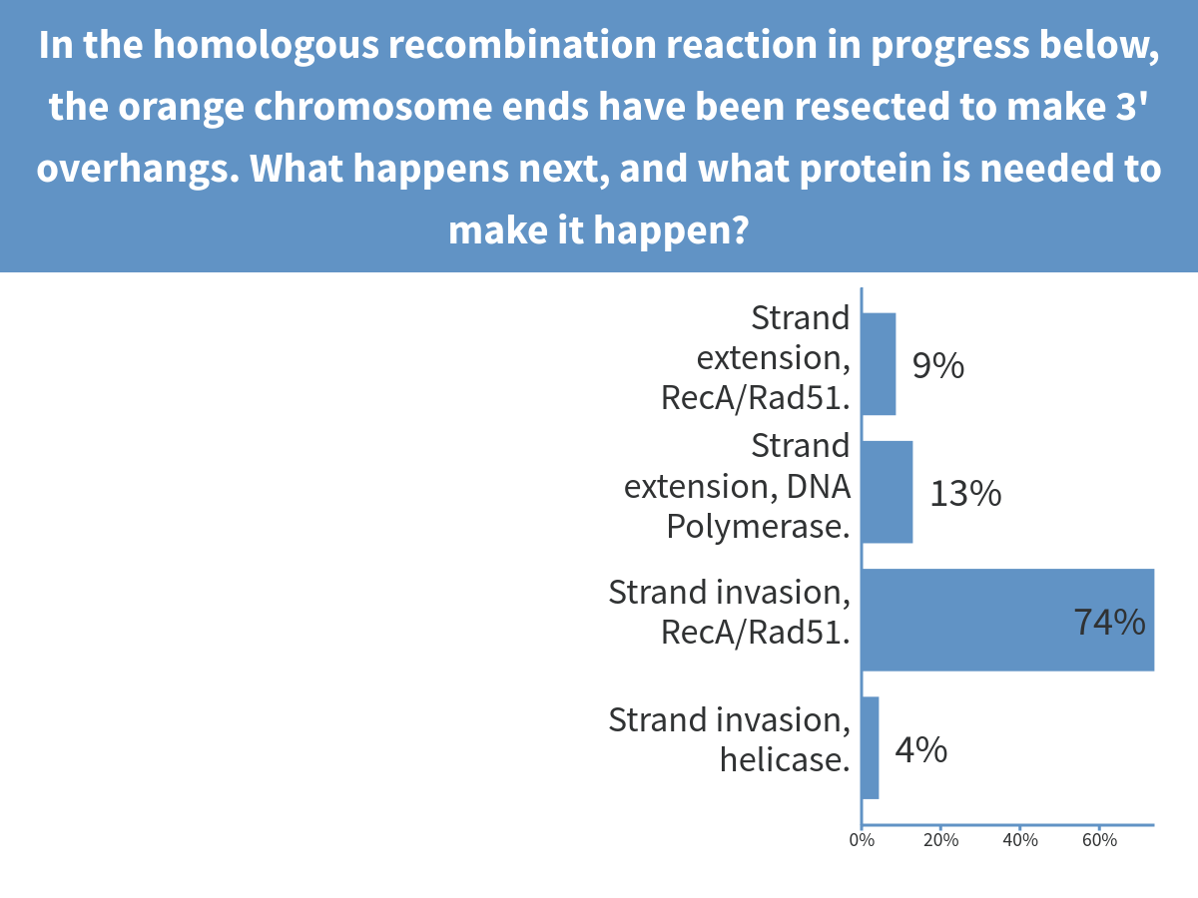
Notes:
In the homologous recombination reaction in progress below, the orange chromosome ends have been resected to make 3' overhangs. What happens next, and what protein is needed to make it happen?

Slide 4
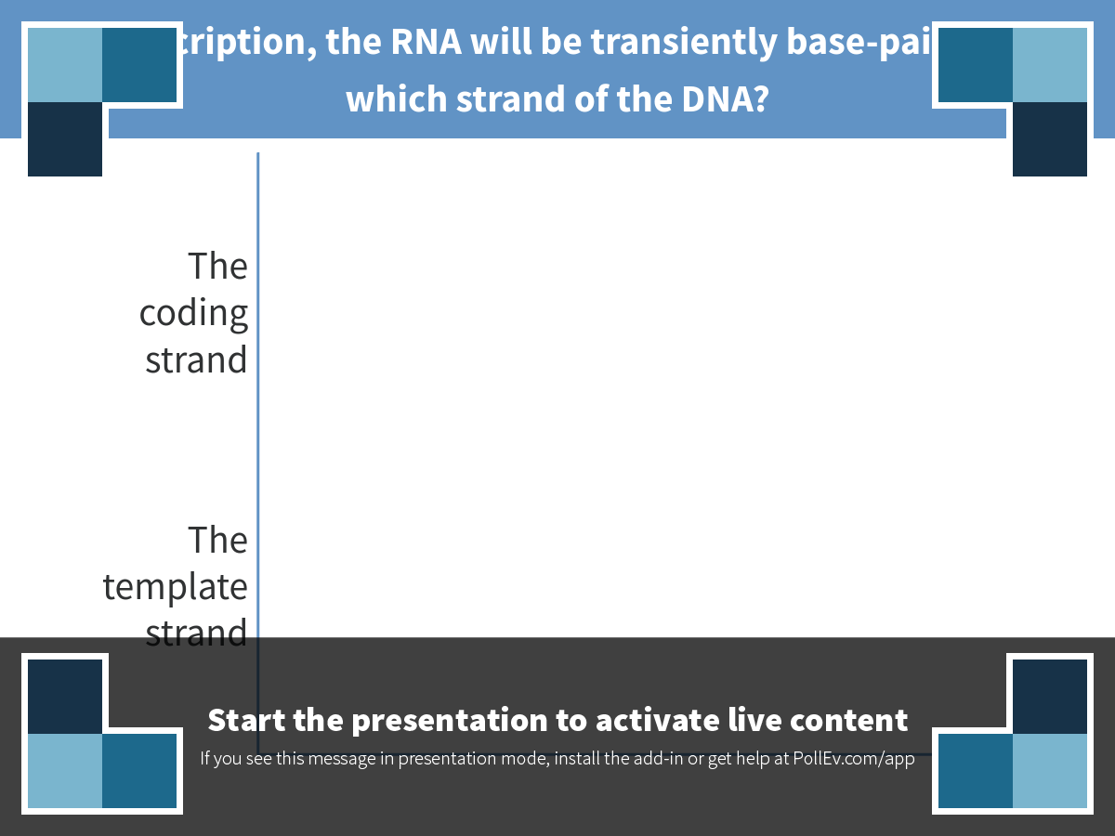
Notes:
In transcription, the RNA will be transiently base-paired with which strand of the DNA?
https://www.polleverywhere.com/multiple_choice_polls/ntlwYoXSeoK3WhF

Slide 5
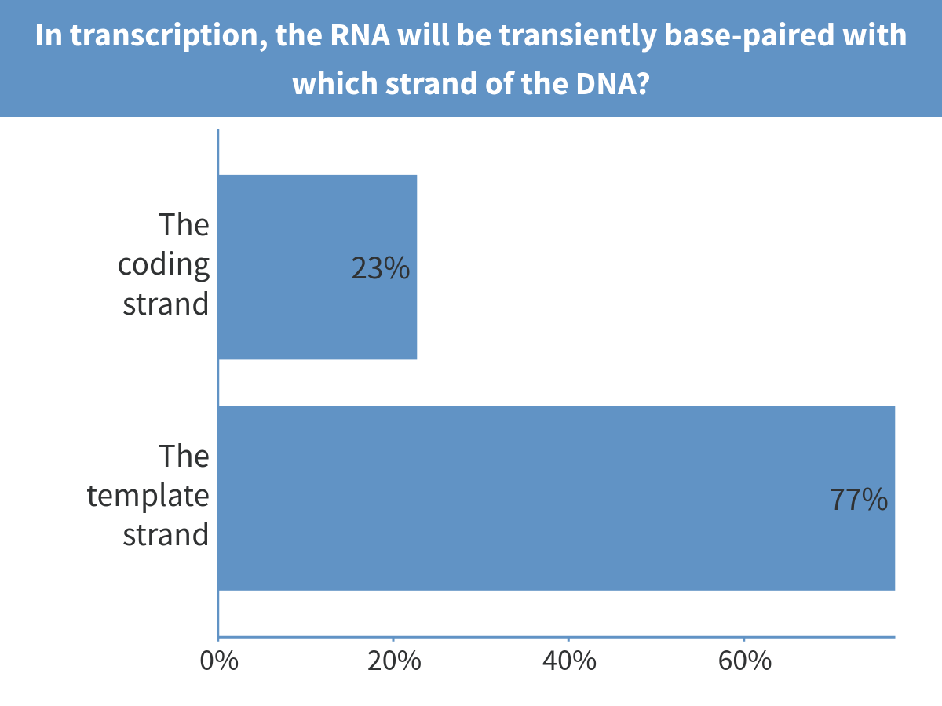
Notes:
In transcription, the RNA will be transiently base-paired with which strand of the DNA?

Slide 6
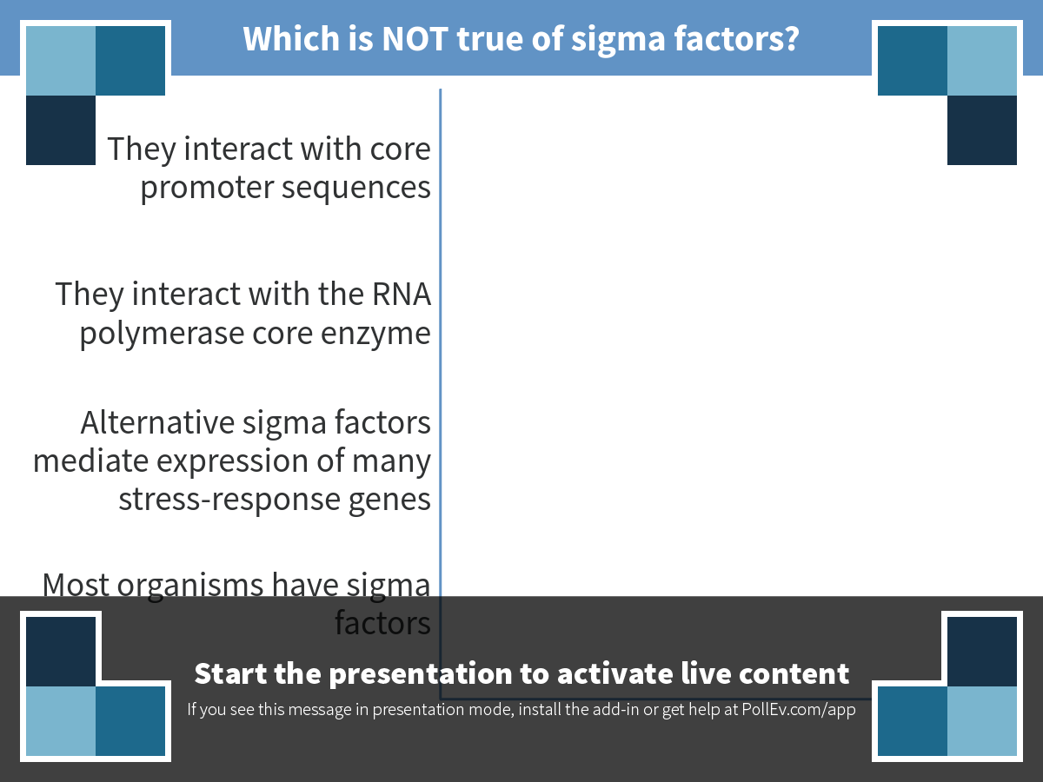
Notes:
Which is NOT true of sigma factors?
https://www.polleverywhere.com/multiple_choice_polls/1suRSB7zsxTH8ZM

Slide 7
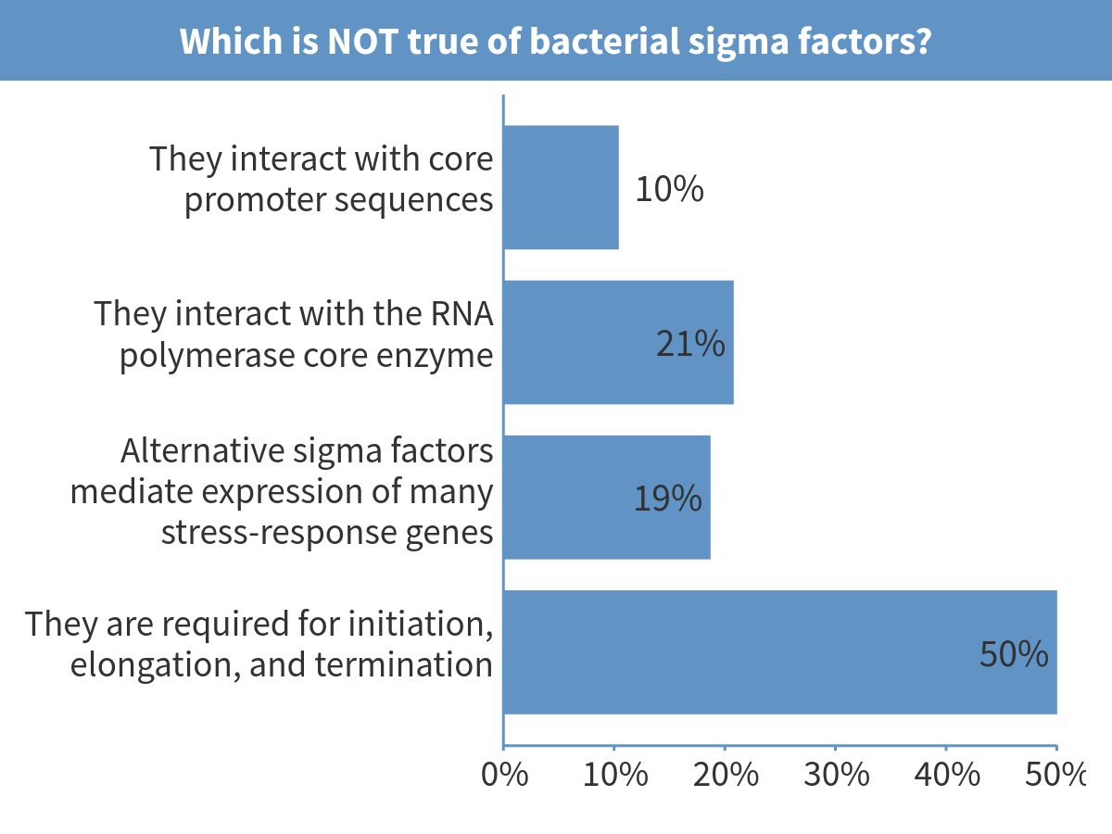
Notes:
Which is NOT true of bacterial sigma factors?

Slide 8
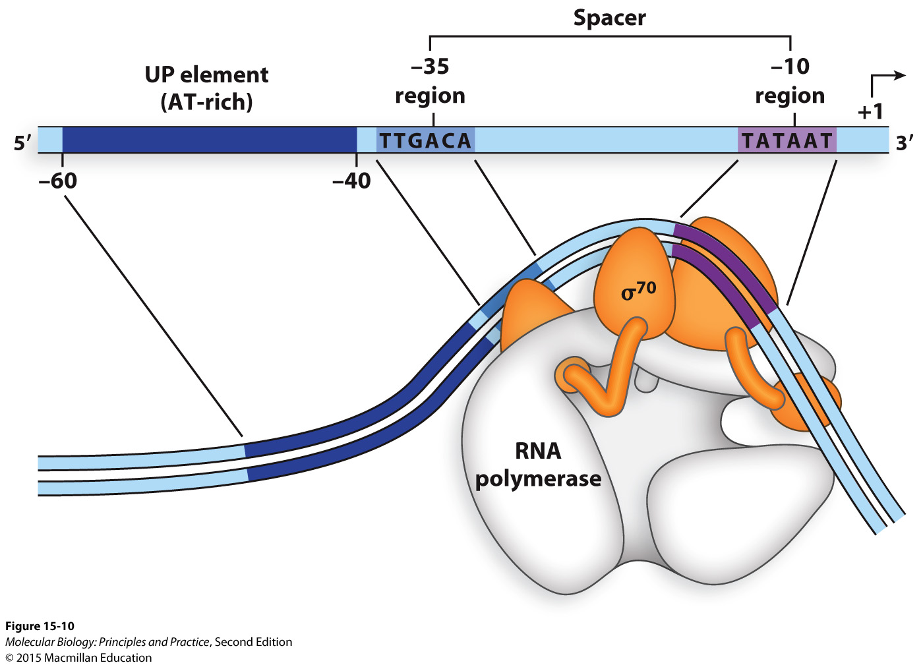
A “housekeeping” sigma factor mediates expression of most genes in normal growth conditions (σ⁷⁰ in E. coli)

Slide 9
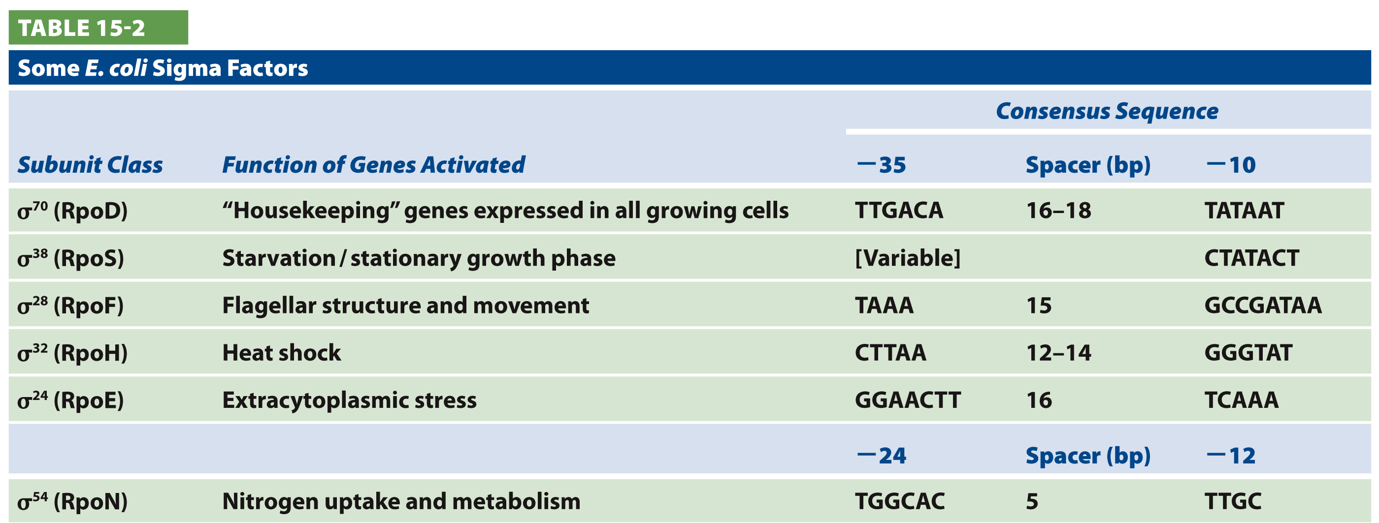
Alternative sigma factors associate with RNA polymerase core to induce expression of stress-response genes

Slide 10
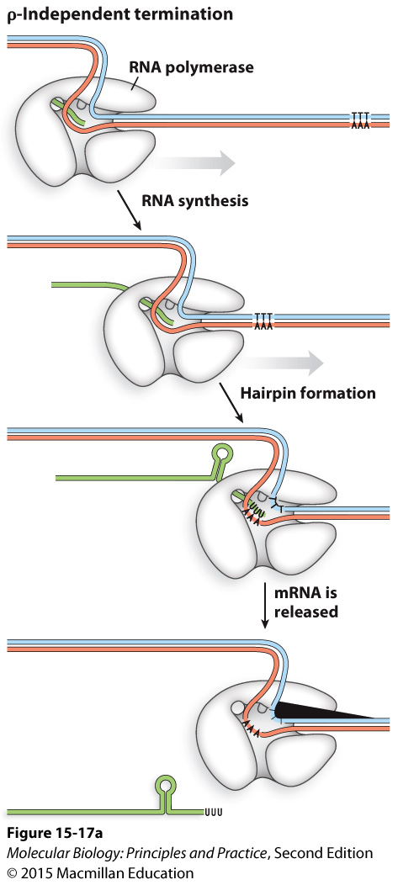
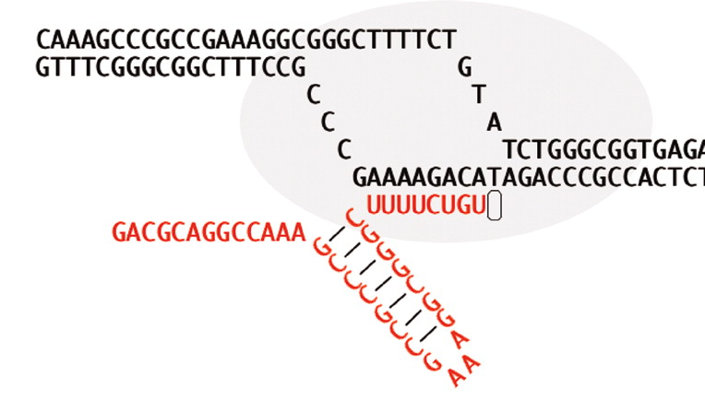
Rho-independent termination (caused by intrinsic terminators)
Park and Roberts, doi: 10.1073/pnas.0600145103

Slide 11
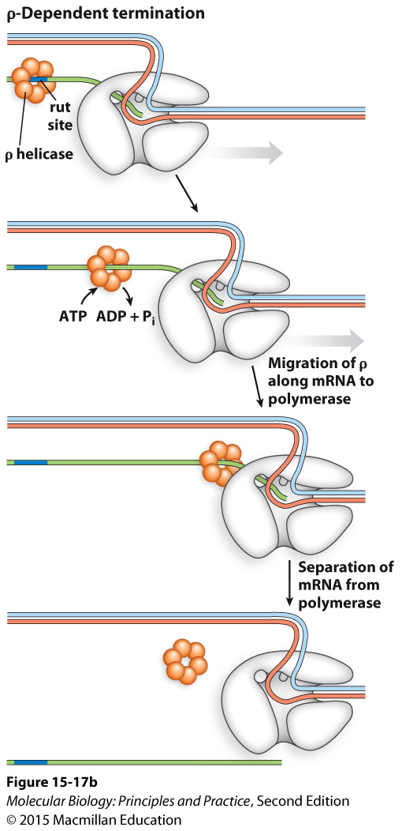
Rho-dependent termination

Slide 12
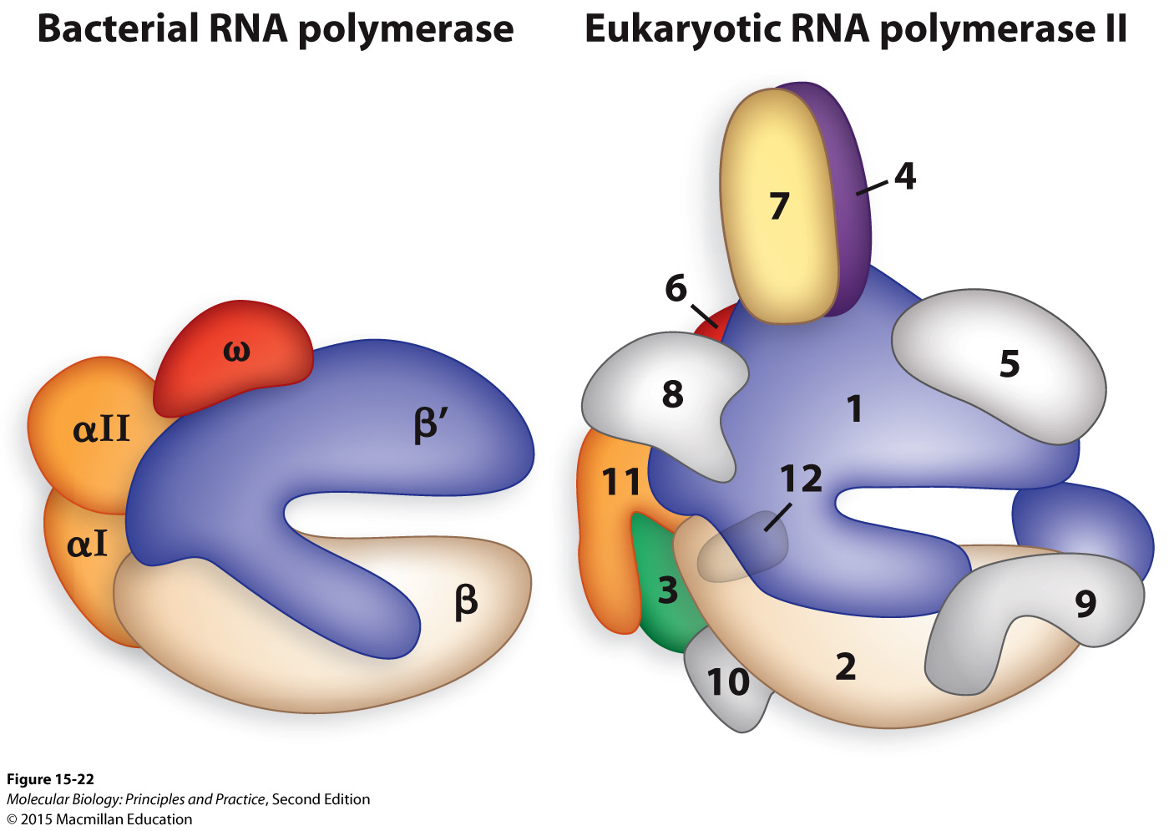
Eukaryotic RNA polymerase II has substantial structural and functional homology with bacterial RNA pol

Slide 13
Eukaryotic RNA polymerases use general transcription factors (TFs) instead of sigma factors
Each RNA polymerase requires a set of general TFs (also called basal TFs) that bind core promoters and are used at all (or most) genes
Additional TFs bind to specific upstream promoter regions or enhancers to regulate transcription

Slide 14
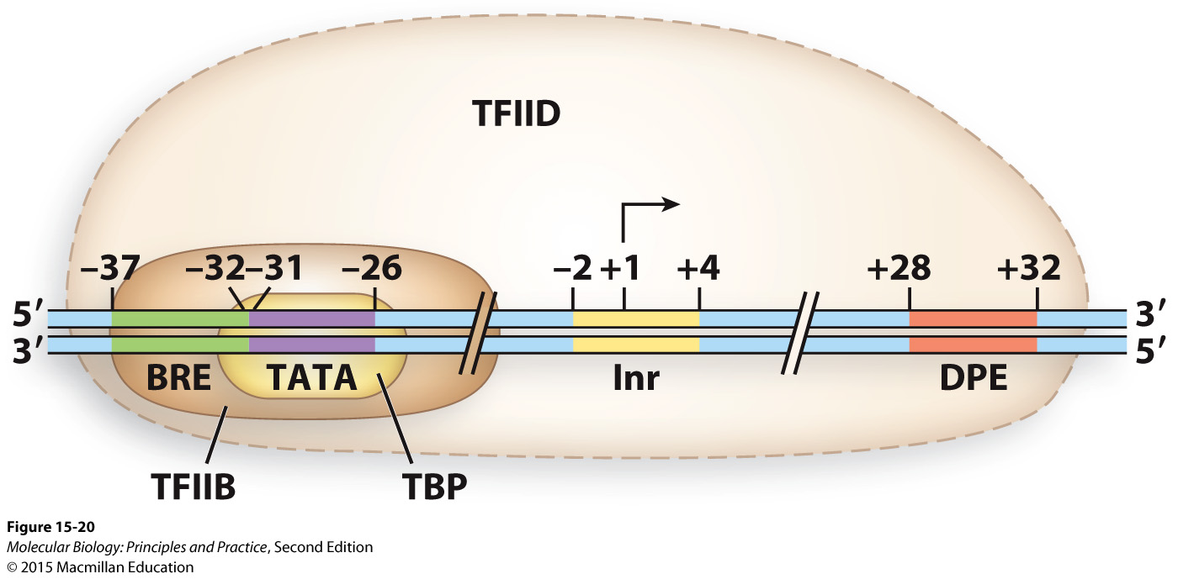
RNA Pol II core promoter bound by some general TFs

Slide 15
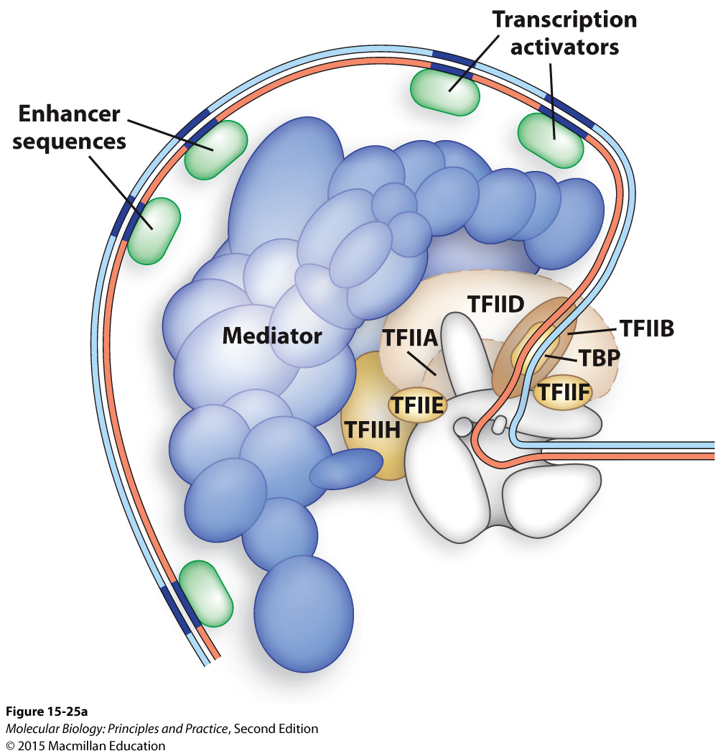
The mediator complex bridges upstream TFs to general TFs

Slide 16
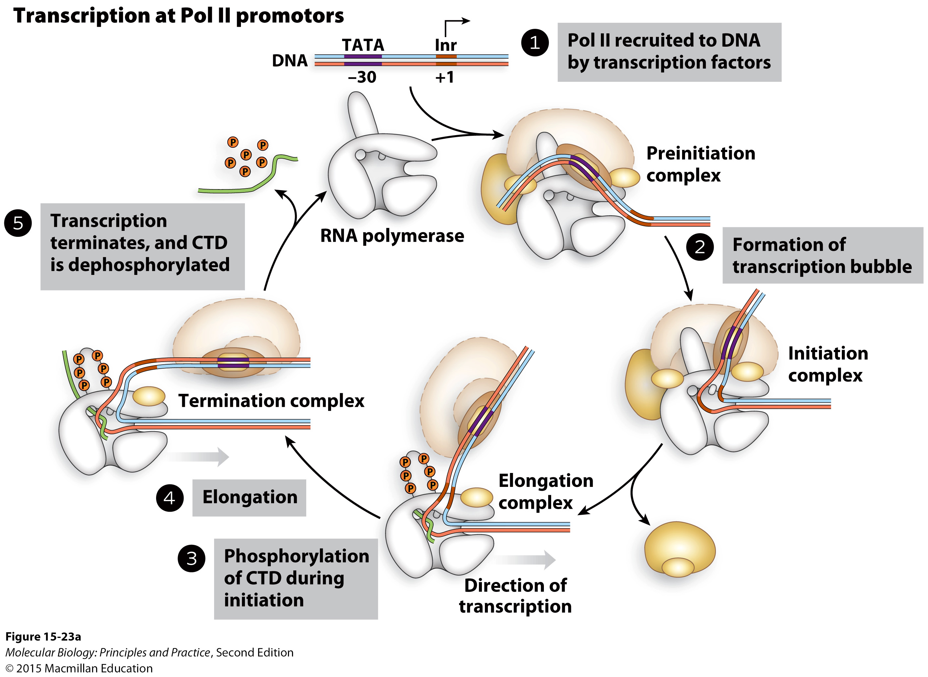
Phases of RNA Pol II-mediated transcription

Slide 17
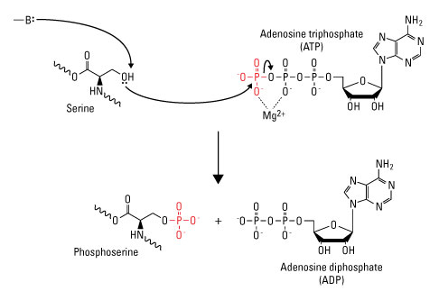
Phosphorylation is a reversible post-translational modification of some amino acid side chains
Graphic: thermofisher.com

Slide 18
Comparing bacterial transcription with RNA Pol II-mediated transcription

Slide 19
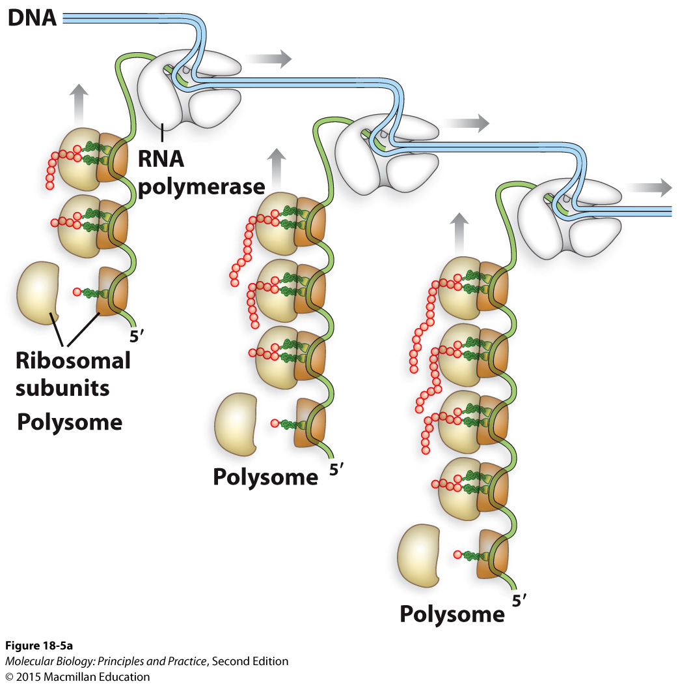
Coupled transcription and translation in bacteria

Slide 20
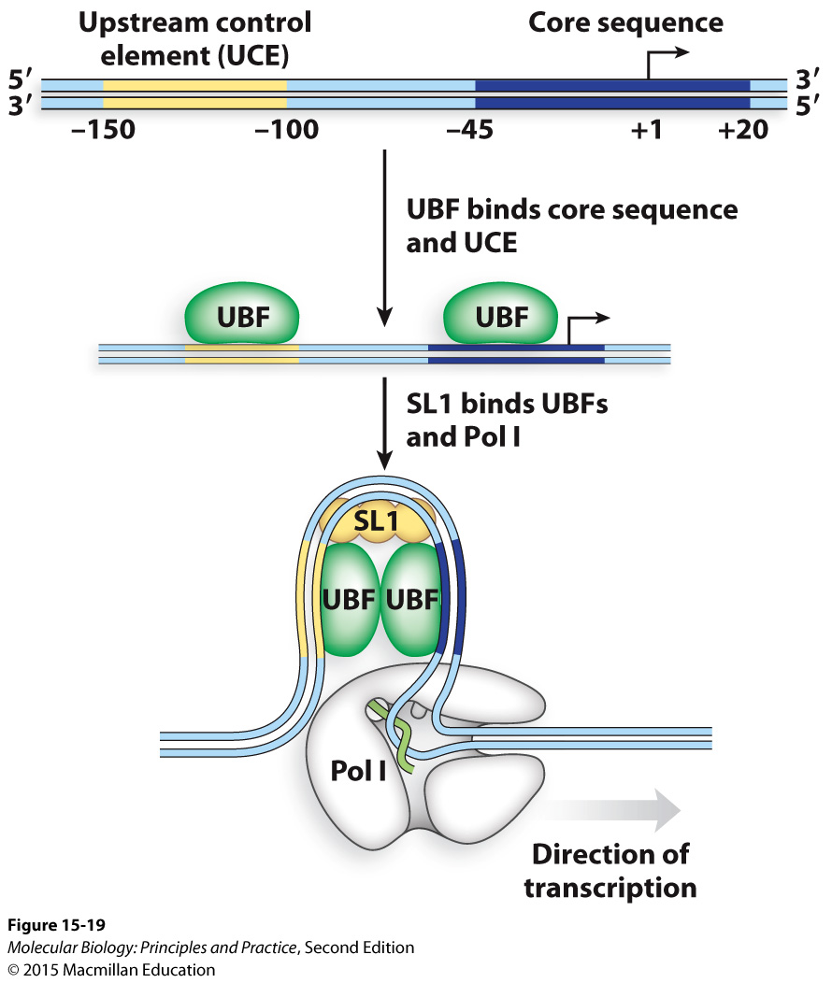
Transcription by RNA Pol I (large rRNA genes)
Notes:
Different promoter elements and mostly different general TFs (TBP is used)
Different termination mechanisms

Slide 21
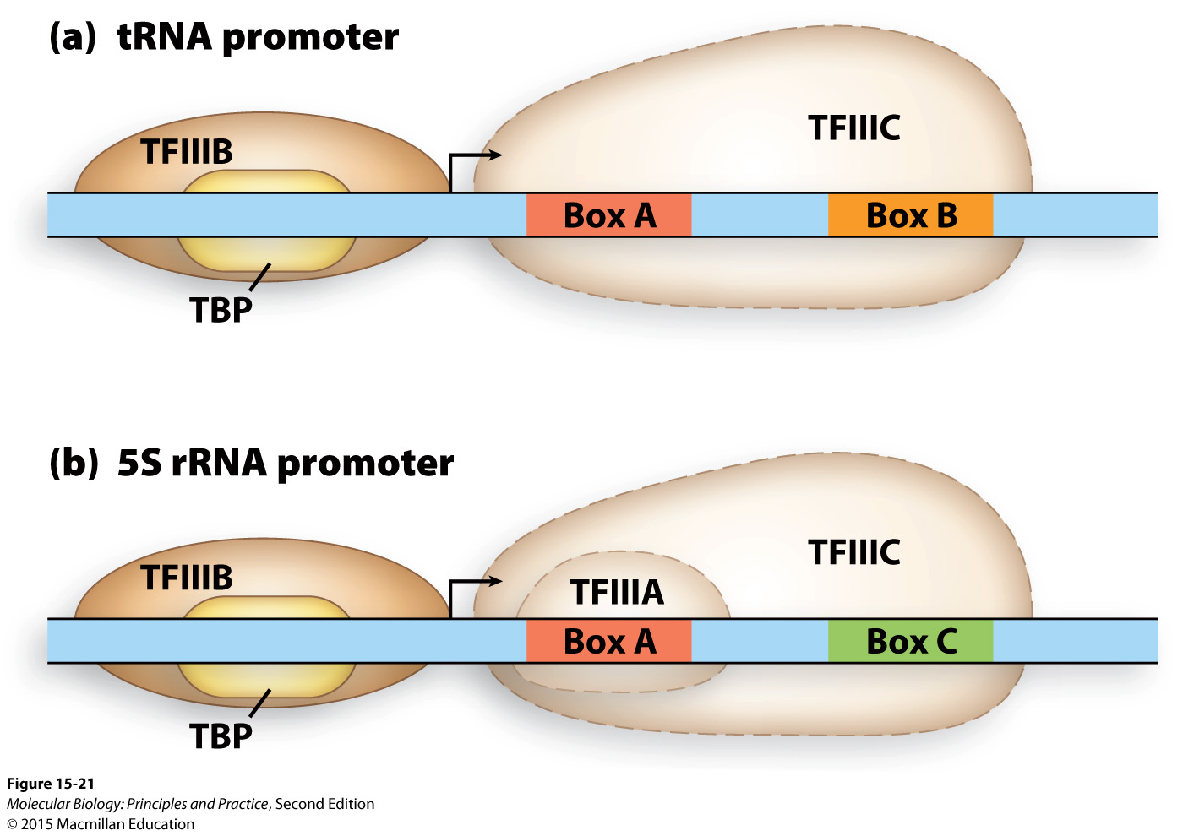
Transcription by RNA Pol III (tRNAs and some other small non-coding RNAs)
Notes:
Different promoter elements and mostly different general TFs (TBP is used)
Different termination mechanisms

Slide 22
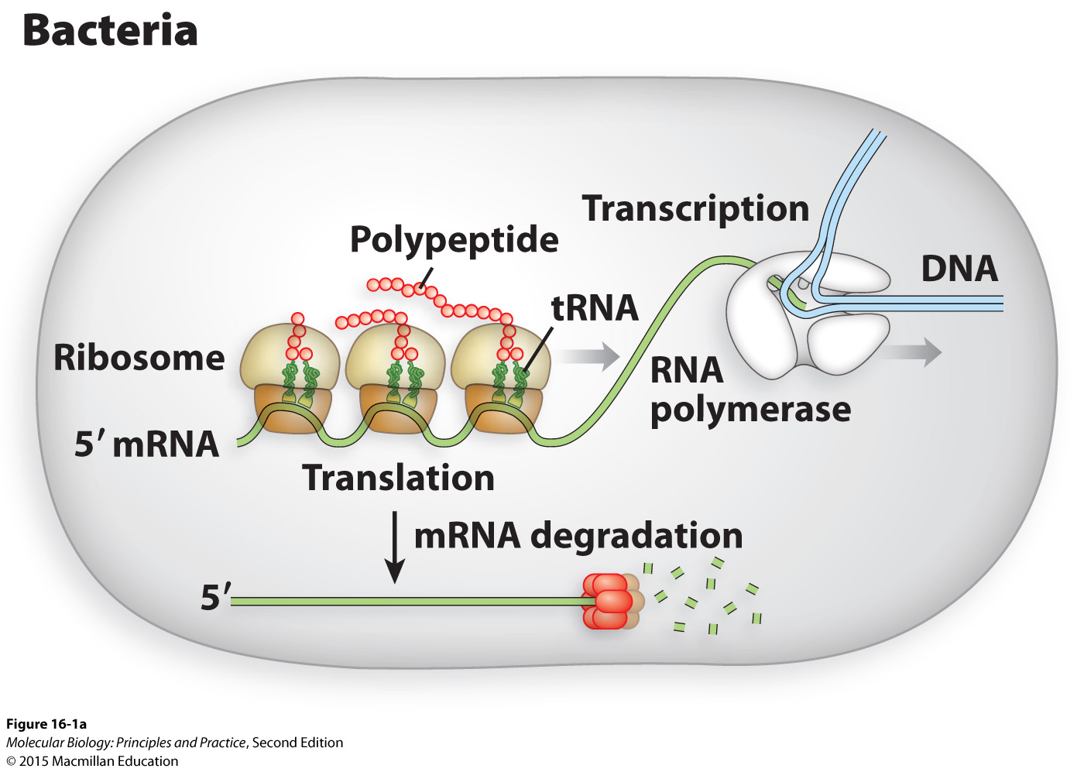
Most bacterial mRNAs are transcribed in their mature forms (primary transcript = mRNA)
Translation begins before transcription is complete

Slide 23
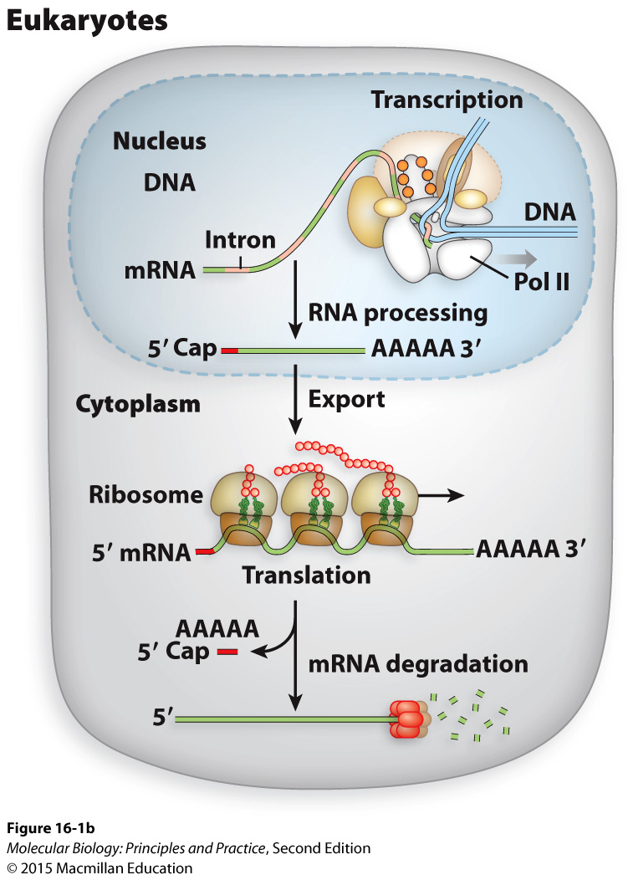
Eukaryotic pre-mRNAs must be processed before nuclear export and translation
Primary transcript ≠ mRNA
Notes:
5’ Cap
Splice out introns
Poly(A) tail

